Slide 1
INTERNATIONAL CLOUD INFORMATION EXCHANGE SYSTEM UNITRAVEL.PRO
For medical and cultural tourism institutions, hotels, inbound and outbound operators, agencies, air companies, tourist offices and bureaus from all around the World.

Slide 2
The first professional social tourist B2B network service for all players of the travel market.
Personal accounts of companies-users are interconnected within one tourism market platform. So that employees of a travel company have at hand all information necessary for their work in one place: photos, video files, text documents, contacts, news.
TOURIST AGENCIES AND OPERATORS
TOURISM BOARDS
MEDICAL TOURISM
AIRCOMPANIES
CULTURAL FACILITIES
HOTELS
SERVICES
The large tourism market guide where you are the co-author!

Slide 3
If you are:
Cultural Facility
theatre, exhibition, museum, circus, musical, any other site with cultural orientation
Medical Tourism
clinic, resort, holiday center, SPA
Traveler Services Company
chartering airplanes, helicopters, yachts, air balloons, recreational facilities, theme parks, etc.
Тhen you know that your clients are not only independent travelers, but also travel agencies all around the world, which send you their clients from different corners of the globe.
Are they aware of your existence?

Slide 4
What is the problem of traditional marketing tools?
Press and Exhibitions
The high cost image-building tools whose efficacy reduces year by year.
Direct Mail
Inefficient, as letters mostly go to spam, especially when they are sent to or from a new contact.
Events and Business Meetings
Low coverage of audience in one event, high cost.
Your Website
Well, your website may contain an events poster, menu and prices, or your main services, but do you know, how much time does an agent need to find, cut and add information from your website into an offer to its client? How many websites of that kind he needs to examine daily? And if information is provided in one language only?

Slide 5
Your main task is to deliver your news or information file for each your market in the relevant language, fast, at low cost and for a wide audience, making it constantly, expanding clients and agents base.
Do you know how many letters and invitations manager of any agency receives each day? Hundreds! And they all go to the bin immediately without being read.
So how can a company like yours effectively advertise and promote the services without spending much time, money and efforts of your staff for this?

Slide 6
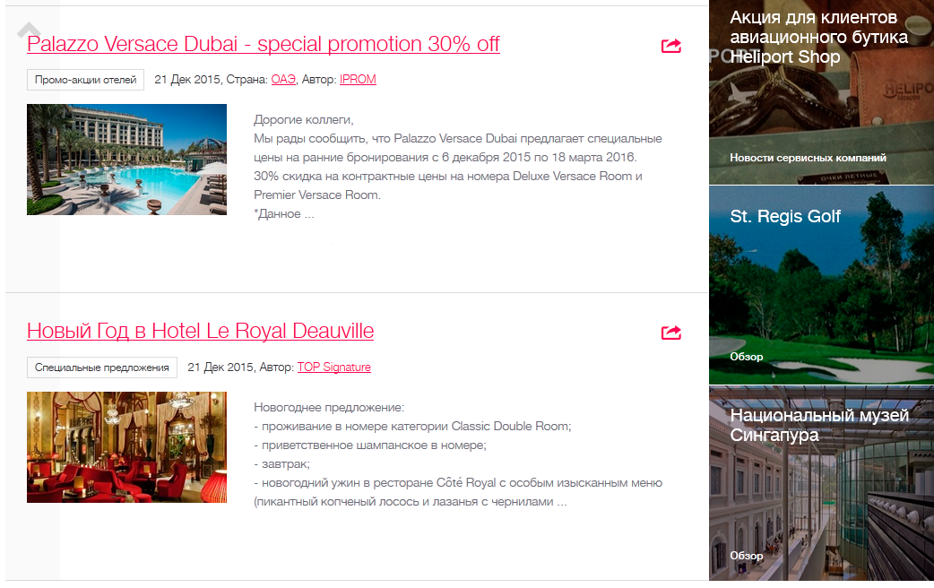
Travel platform Unitravel.pro can easily solve this task, offering a range of promotional tools at once:
News Block
Here you can post your news without limitation, without sending unsolicited e-mails to your potential customers. The block is arranged as a news feed, similarly to Facebook and the like social media. Any user of the tourism platform can catch it right from the block and repost it either for its agencies or to its accounts in Facebook, Twitter, Instagram, Vkontakte
Знаете, сколько писем и приглашений в день получает менеджер любого туристического агентства? Сотни! И все они немедленно попадают в корзину, не будучи прочитанными.
11
34
28
41
28
96
17
25
Your news will spread exponentially!

Slide 7
News Block
0/4/6488
0/0/16
0/13/148
0/37/3
reposts / likes / user coverage
After having published your news posts in our platform you can see which ones are the most popular among our users, how many reposts to social media has each post, how many people liked it, as well as total post users coverage for each social network. In order to ensure your promotion and news block efficiency control we send you news post statistics weekly/monthly.

Slide 8
News Block
From Unitravel.pro you can broadcast the news to our b2c news portal for direct clients: www.travelinfo.pro
Cost* of unlimited posting
at Unitravel.pro + Travelinfo.pro
1 month
1 year
40 USD
350 USD
Also, right from the Unitravel.pro platform you may order translation of your news to any language from your Personal Account!
* After 6 months trial period

Slide 9
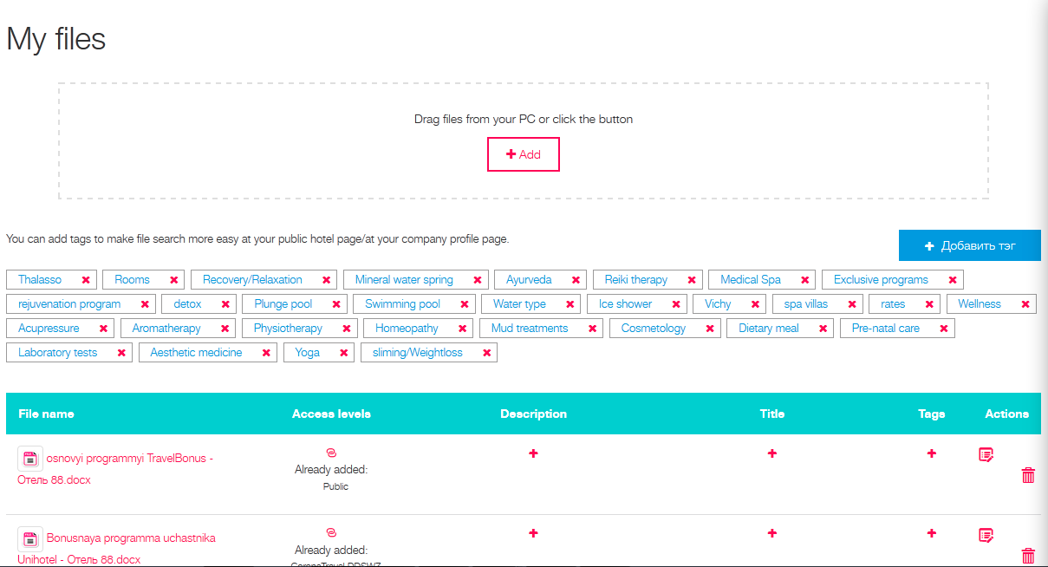
My Files. Cloud File Storage
Upload any files needed for your partners for work free of charge to your Personal Account at Unitravel.pro.
Photos
Video files,
Special offers
Seminars
Schedules
Events
Maps
Prices
Mark files that will be available for all users of the platform as public ones (Public).
Mark files available only to certain partners (Agencies).
Use visibility settings: for my personnel, agencies, public.
Use hash tags for each file to let other users find them quickly in your profile.

Slide 10
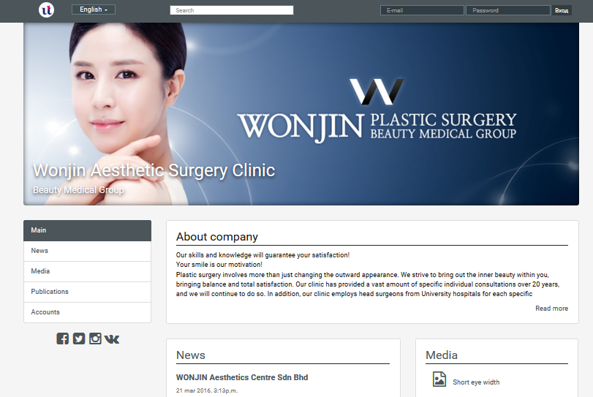
Your Company Profile
We will make for you a company profile in any language free of charge, to use it as your online business card in cooperation with travel agencies and partners. Company profile is created free of charge and based on your data and added content: photos, video, contacts, tours and programs, files for work.
We credit* only a fee for maintenance of your website:
1 month
40 USD
1 year
350 USD
* After 6 months trial period

Slide 11
Contact Management and Chat
Add your partners and clients to a chat to have information at hand at any time, available to all your staff.
Any number of your personnel can work through one account in your Personal Account,
assign them different administration rights,
make some contacts public, so that any user of Unitravel.pro could contact them through a convenient chat, without the need to use mail and numerous ICQ/SKYPE. All messages will immediately go to the chat message system, it is not necessary to know your email or ICQ/SKYPE for this.

Slide 12
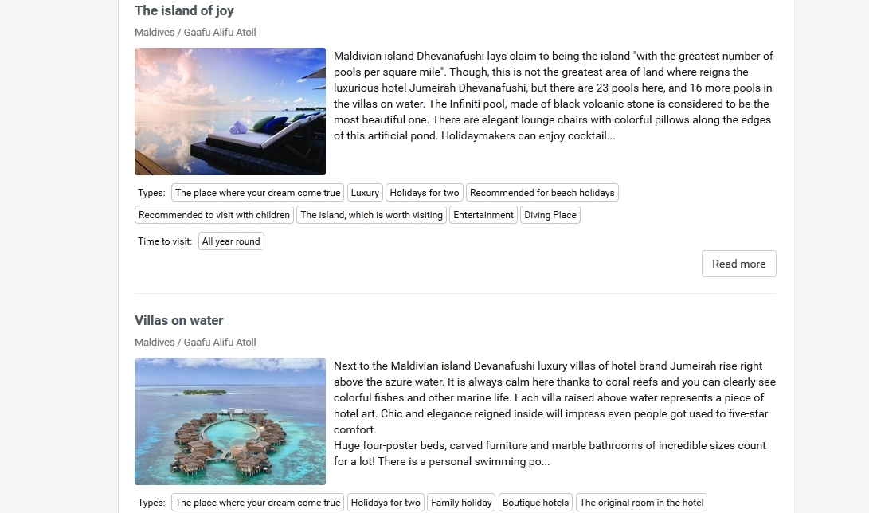
Posts Collection for your advance promotion
Create collections of your own notes about a SPA, clinic or service that are relevant at any time or by seasons!
Write a small essay of 5-10 sentences, add a high quality photo to it and publish it on our travel platform.
Adjust your posts’ visibility settings for everyone or only for some of your partners, and any willing agencies around the globe will be able to repost them on their pages in social networks, using them as basic news feeds.
Thus you will be able to promote your services and events even more efficiently and for a larger public! Build your audience by yourself!

Slide 13
You’ve become closer to your agents and direct clients now!
WE WISH YOU GOOD SALES AND EASY PROMOTION!

