Slide 1
PRESENTATION SERIES
Unique tools and services of Unihotel.org platform

Slide 2
Unique tools and services of Unihotel.org tourism platform
EFFECTIVE AND EASY UPLOADS FOR YOUR HOTEL
HOTEL PROMOTION IN THE INTERNET

Slide 3
Information age dictates its rules — information load on hotels grows every day, and now in addition to regular employees hotels have to recruit extensive staff to work on the Internet:
Load on system administrators and programmers grows at an exponential rate
promotion - Department of digital marketing
sales E-commerce

Slide 4
Commercial sites for photo and video file uploads, such as Leonardo.com or posting on Instagram, Youtube, etc.
Sites offering advice from travelers, such as Tripadvisor.com
In order to keep up with the times a hotel spends a lot of time and money on web-channels, critical for its promotion:
Huge number of booking systems – Booking.com, Expedia.com, Hotels.com, etc.
News web-sites, as a rule, happen to be commercial too...
And you also need to keep your personal accounts on Facebook, Twitter, LinkedIn and other social media…
And dedicated staff have to be allocated for each of these systems in order both to keep the English version and represent the hotel in different countries.

Slide 5
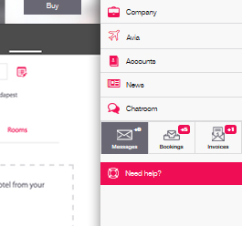
Hotels now particularly need universally applicable adjustable means to operate such data streams – so that all hotel information is simultaneously transmitted and uploaded to various systems with a few simple steps at minimum costs.
Cut down time expenditures
Minimize staff without compromising quality

Slide 6
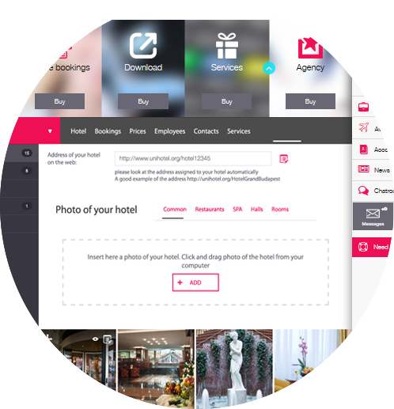
Signing in Unihotel.org tourism platform for free will let you upload all hotel materials absolutely free of charge: descriptions of rooms, restaurants, SPA, nurseries, menus, wedding and other programs, as well as free upload of any amount of photo and video materials.

Slide 7
Fast and easy creation of news in your Personal User Account at Unihotel.org will allow you to promote this news through several channels simultaneously
to public hotel page accessible for the
client
promote the news among your partners and travel companies in the news block for each country or hotel in Unihotel.org
upload news to social media, such as Facebook or Twitter, Linkedin, etc.
to hotel website

Slide 8
HOTEL INFORMATION
All photos, videos, descriptions of rooms, hotel premises, restaurants and SPA, etc. can be uploaded for further use on a hotel public page at Unihotel.org. Any travel company manager worldwide can send this link to their direct client.
It also contains news of your hotel and all current SPO's, calendar of availability or stop sales, map and all additional files — SPA, wedding programs, restaurant menus, etc.

Slide 9
All this information can also be easily uploaded to all global
BOOKING SYSTEMS, SEARCH ENGINES AND FEEDBACK SYSTEMS
AND ALL SIMILAR SYSTEMS

Slide 10
All this information can also be
EASILY DOWNLOADED FROM UNIHOTEL.ORG INTO GDS SYSTEMS

Slide 11
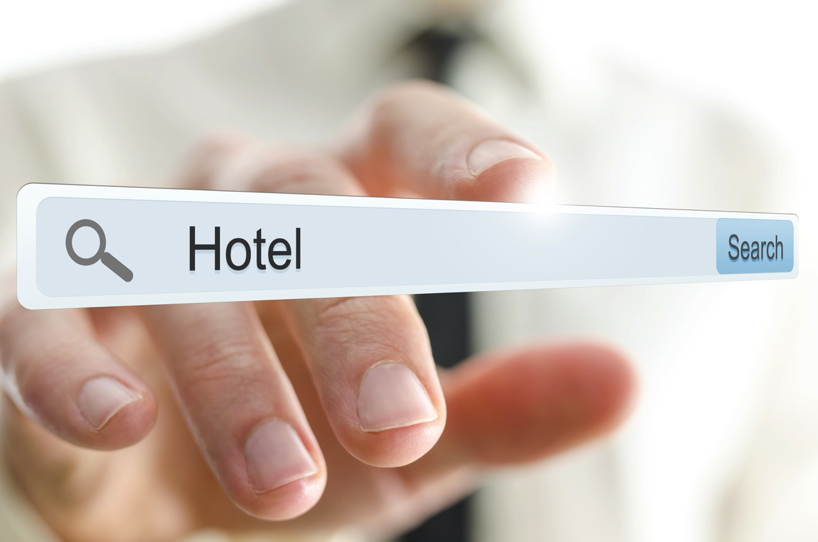
All commonly used existing systems (Expedia, Agoda, Booking, etc.)
ARE ISOLATED AND DEVOID OF SINGLE UNIFICATION STANDARD
All hotels have another global problem

Slide 12
This does not allow search platforms and systems to collect current information on availability and prices from your hotel online and display it in the client's search results, the way it is currently done on such platforms as AviaSales, Skyscanner, AnyWayAnyDay, Onetwotrip, Kayak, etc. for the search of airplane tickets.

Slide 13
You get the opportunity to enter the unified hotels catalogue using the hotel ID-number
02
03
Accessible to all search engines, catalogues and platforms worldwide.
01
By signing in Unihotel.org
free of charge
04
This is a sort of unification of hotels with global identification system similar to the existing IATA - International Air Transport Association.

Slide 14
Until present nobody has done or offered anything similar for you in the travel services market
Search
Identification
Entry into base
And this significantly facilitates search, identification and entry of any hotel, even the smallest one, into any search platform anywhere in the world; and allows to use current data on SPO's, prices and descriptions through global search systems

Slide 15
Therefore, the data synchronization issue can be successfully resolved within the universal Unihotel.org platform allowing to upload and download data to and from various systems worldwide
The Unihotel.org team is ready to listen to all your requests and customize your Personal User Account so that all your data is easily and smoothly distributed through all the channels you need.

Slide 16
Unihotel.org platform raises awareness of tourism market and your partners, thus helping you promote and increase your sales in any market.
WISH YOU BIG SALES
AND SMOOTH PROMOTION!

